Slide 1

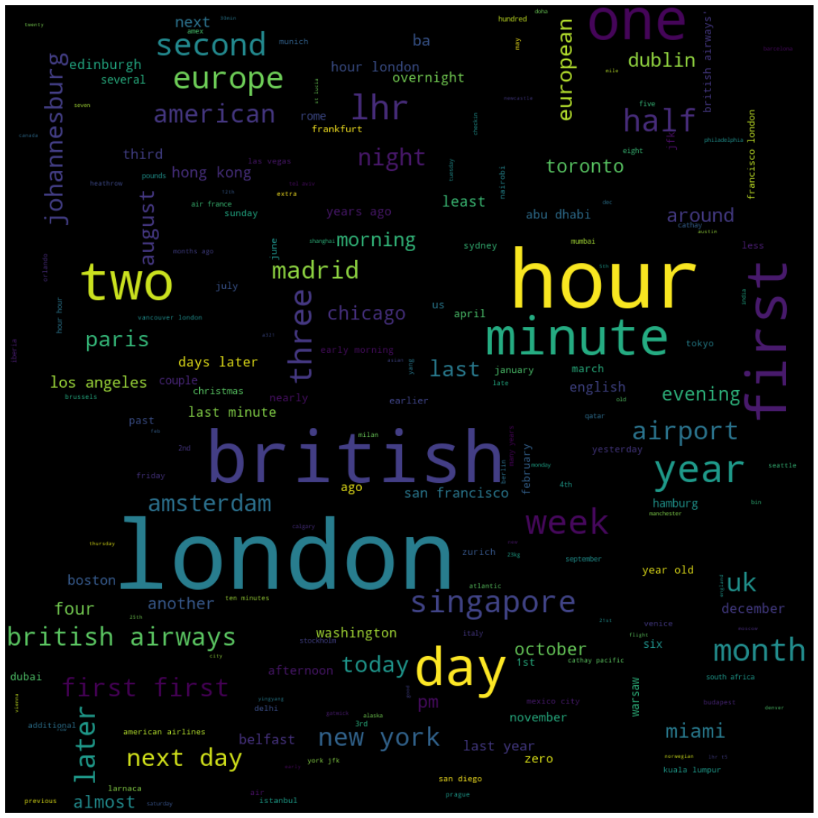
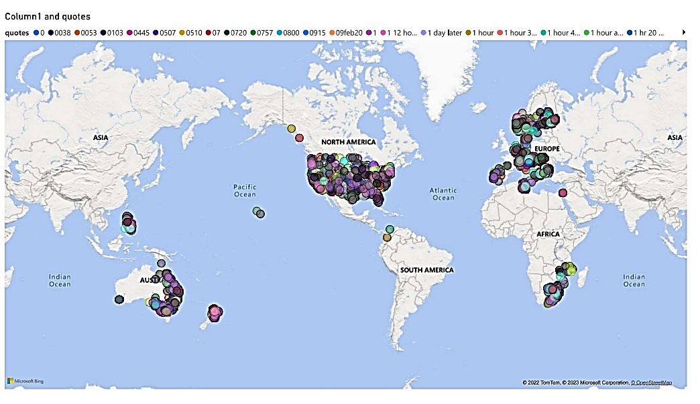
BRITISH AIRWAYS
Summarising the scarped data from the website, collected reviews of customers , according to that, visualisation is created using Text Mining and the words of data has represented in different format.
The data are generated throughout globe based on location

Slide 2
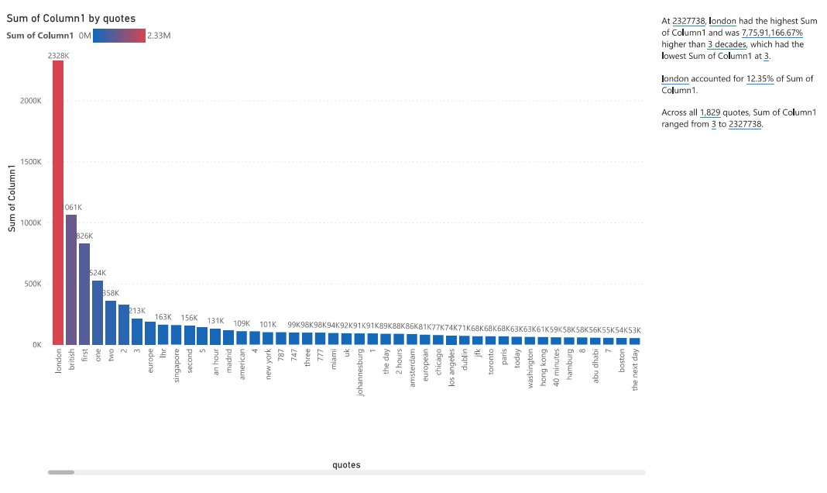
Fig: shows the value counts of the data used in review.

